Slide 1


Development of a catalog of federated SPARQL queries in the field of Rare Diseases
Marc Hanauer marc.hanauer@inserm.fr

Slide 2
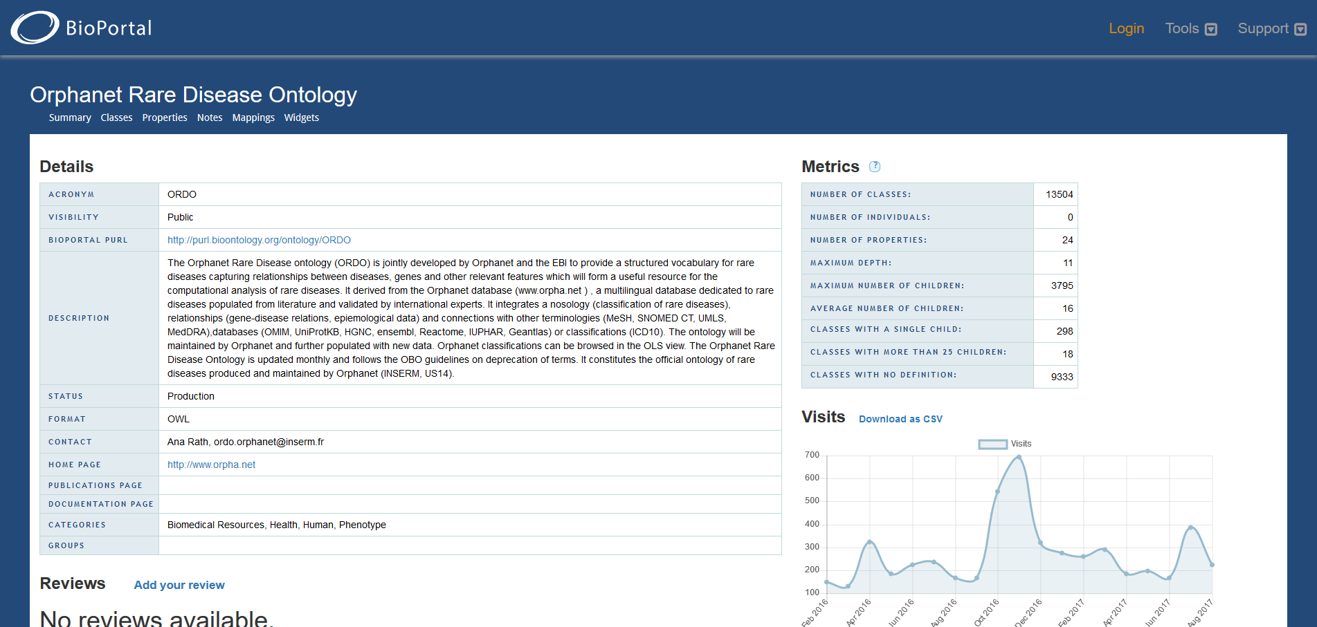


Background information - Context of the project
BioHackathon Paris – 12/16 Nov 2018
Notes:
Diapo de Charlotte: frise 20 ans

Slide 3
Background information - Context of the project
Orphanet
SPARQL
Reactome
SPARQL
wikipathway
SPARQL
Uniprot
SPARQL
wikidata
SPARQL
EBI
SPARQL
Disgenet
SPARQL
Any relevant
SPARQL
BioHackathon Paris – 12/16 Nov 2018
Notes:
Diapo de Charlotte: frise 20 ans

Slide 4
Expected Outcomes : Solving puzzle Federation !
Orphanet
SPARQL
wikipathway
SPARQL
Uniprot
SPARQL
wikidata
SPARQL
Reactome
SPARQL
Disgenet
SPARQL
EBI
SPARQL
Any relevant
SPARQL
BioHackathon Paris – 12/16 Nov 2018
Notes:
Diapo de Charlotte: frise 20 ans

Slide 5
Expected Outcomes
We propose to try to:
Obtain an (editable) catalogue of relevant sparql in the field of RD.
Provide (or list existing) sparql queries for each sources, relevant for RD
Give access to federated sparql queries across sources with example
Provide nice web interface to end-users
Enjoy!
BioHackathon Paris – 12/16 Nov 2018
Notes:
Diapo de Charlotte: frise 20 ans

Slide 6
Approaches to reach goals / Hacking organisation
Tasks can be done in parallel
Identify each relevant sources. Give a quick definition. List existing or craft sample query for RD perspective.
Setup a web interface to manage resource information and queries (jupyter note book ? Lodestar ? YASGui…) : your expertise is needed !
Play time : try to setup several federated queries around sparql endpoints
your expertise is needed !
BioHackathon Paris – 12/16 Nov 2018
Notes:
Diapo de Charlotte: frise 20 ans

Slide 7
Skills Needed
SPARQL masters, ontologists
Python, Web API, RDF
Expected hacking days: 4 days
BioHackathon Paris – 12/16 Nov 2018
Notes:
Diapo de Charlotte: frise 20 ans

Slide 8
LINKS
Project representation at the biohackathon
Marc Hanauer, Orphanet INSERM
Invited resource people and associated expertise
Andra Waagmeester, Micelio
You !!
Biohackathon project: https://bit.ly/2P406Jd

